Slide 1

Looking at Covid-19 impact through Data
By Jacopo Belardo
Notes:
COVID-19 has been one of the biggest challenges the world has faced in recent years. While it’s clear the pandemic affected everyone, the true impact of the virus has been a topic of debate. That’s why I decided to look at the data to see if it could help us better understand the situation and clear up some of the controversy. By combining information from different sources, I hope to use numbers and facts to tell a clearer story about what really happened.

Slide 2
Agenda
Deaths Caused by Covid-19
Impact of Vaccines
Final Thoughts
Notes:
Here’s how I’ve organized this analysis: First, I’ll focus on the number of COVID-19 deaths, starting with a look at different geographic areas and then diving into demographic factors like age and gender. After that, I’ll move on to how we fought the pandemic, focusing on vaccines and their impact. Since vaccines are a very debated topic, I wanted to see if the data shows how effective they were. Finally, I’ll wrap everything up with key takeaways and what we can learn from this analysis.

Slide 3
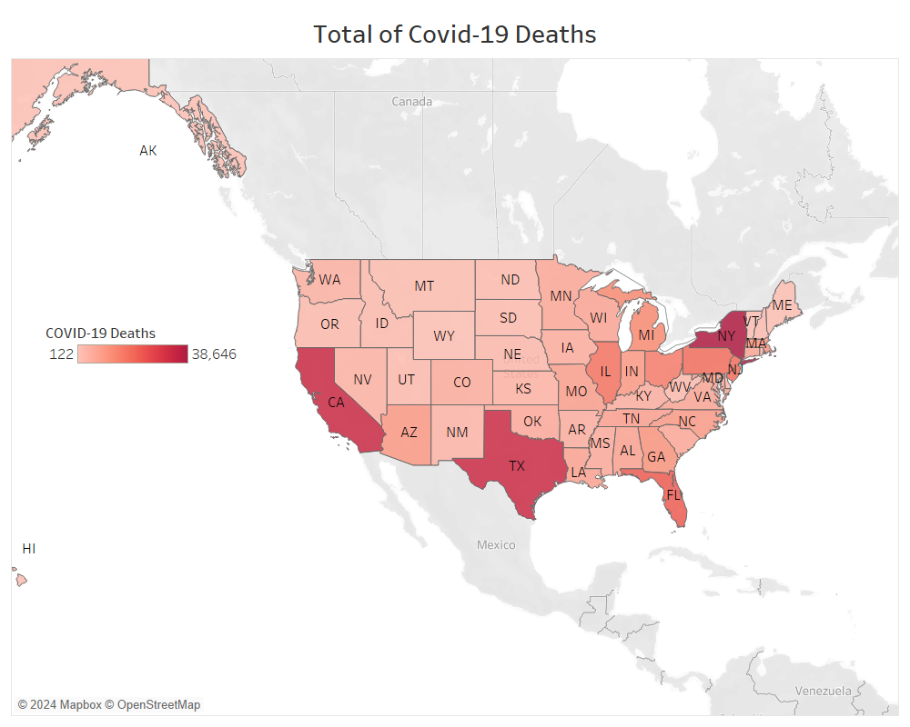
Overview of the United States
Notes:
I want to start by taking a broad look at the impact of COVID-19 across the United States to get a sense of the pandemic’s overall scope. This map shows the total number of COVID-19 related deaths in each state, giving us a clear picture of how the virus affected different parts of the country. One noticeable trend is that COVID-19 had a greater impact on the coasts, where population density is much higher. This makes sense since densely populated areas are more vulnerable to the spread of a virus.

Slide 4
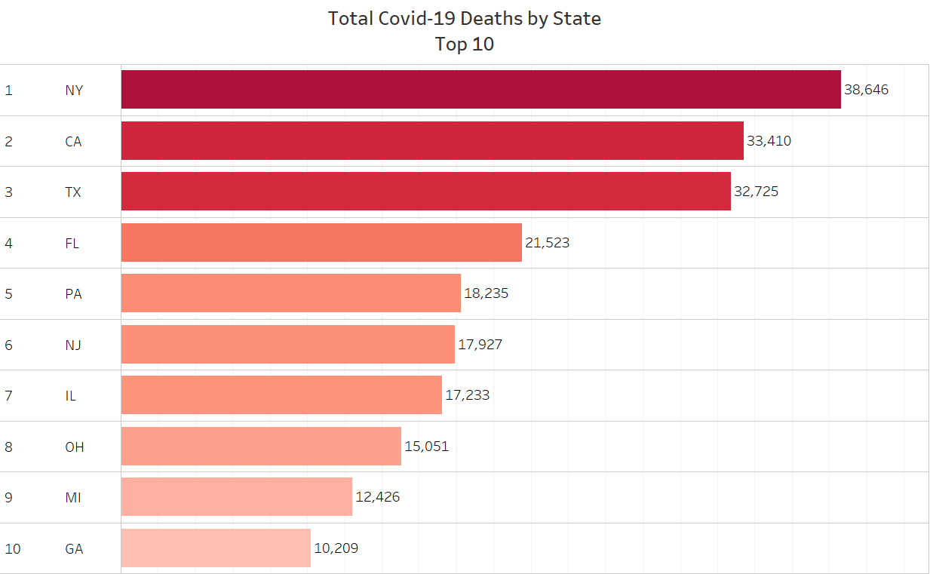
Impact on individual States
Notes:
Now, let’s zoom in on individual states to see which were hit the hardest. This graph supports the idea that densely populated areas were most affected. States like New York, California, Texas, and Florida, home to some of the nation’s largest cities, became major hotspots for the virus. The rest of the top 10 states, including places like Illinois (with Chicago), Michigan (with Detroit), and Georgia (with Atlanta), also show how larger cities played a big role in the spread of the pandemic.

Slide 5
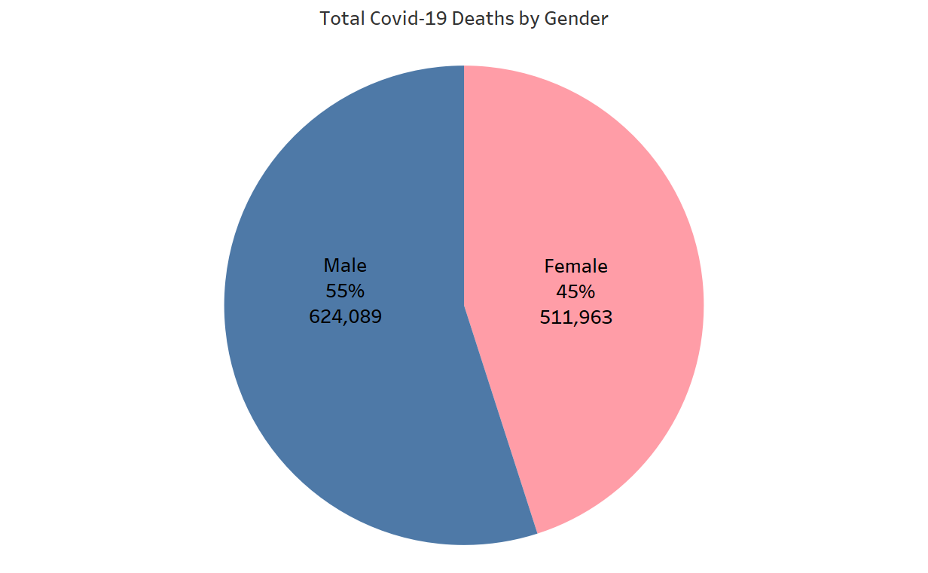
Comparing Genders
Notes:
Looking at some demographics, this pie chart breaks down COVID-19 deaths by gender, revealing a significant difference in impact. As shown, males accounted for 55% of the total deaths, while females made up 45%. This disparity might be linked to biological factors, differences in preexisting conditions, or even behavioral factors such as occupational exposure or healthcare-seeking behavior. It highlights the importance of considering gender-specific factors in pandemic response and public health strategies.

Slide 6
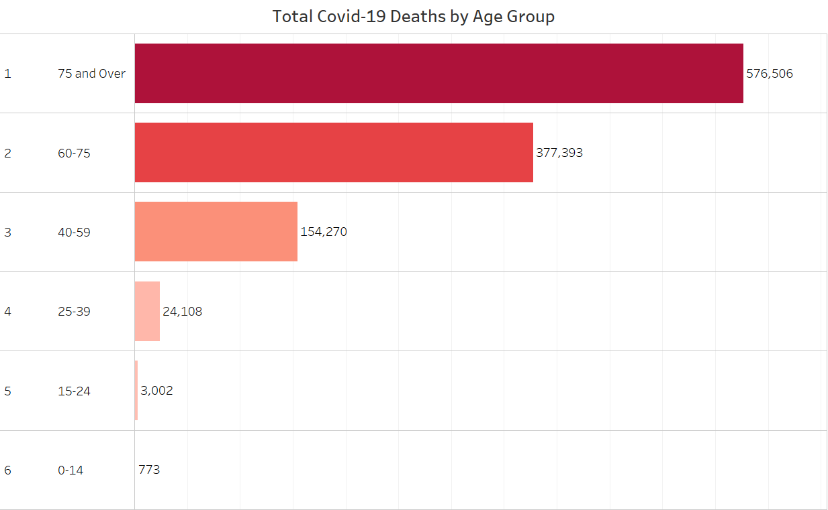
Impact on different Age Groups
Notes:
Continuing the discussion on demographics, this bar chart shows COVID-19 deaths broken down by age group, highlighting a clear trend: older populations were disproportionately affected by the virus. The '75 and Over' group accounts for the largest number of deaths, followed by the '60-75' group, together making up the vast majority of fatalities. This reflects the higher vulnerability of older adults to severe complications from COVID-19. Meanwhile, younger age groups, particularly those under 40, experienced significantly fewer deaths, likely due to stronger immune responses and fewer underlying health conditions. These patterns emphasize the importance of prioritizing older populations in healthcare responses and vaccination efforts.

Slide 7
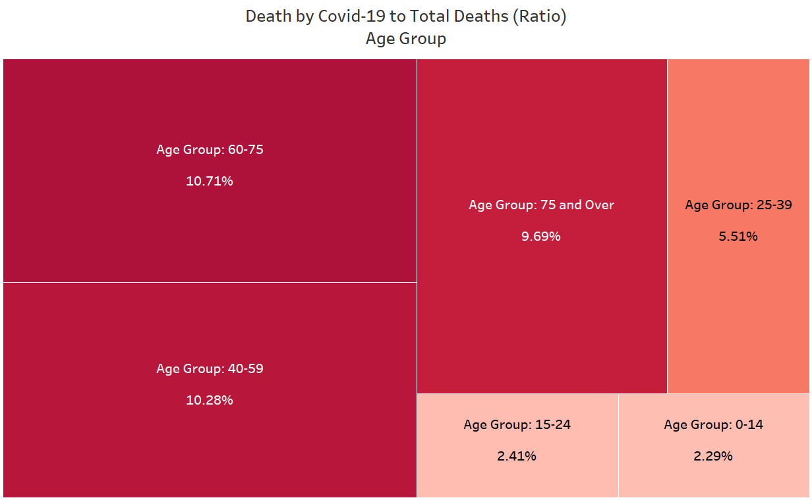
Interesting insights on Age Groups
Notes:
Here, we uncover some surprising insights about age groups that challenge the idea that only the elderly were significantly at risk. While the '75 and Over' group experienced the highest number of deaths, this chart shows that the '60-75' group actually had the highest ratio of COVID-19 deaths to total deaths, at 10.71%. The '40-59' group follows closely with a ratio of 10.28%, demonstrating that middle-aged adults were also heavily affected by the pandemic. Even younger people under 25, though less impacted overall, were not entirely spared. These findings highlight that while the elderly faced the greatest danger, COVID-19 had serious consequences across all age groups (an issue that cannot be underestimated).

Slide 8
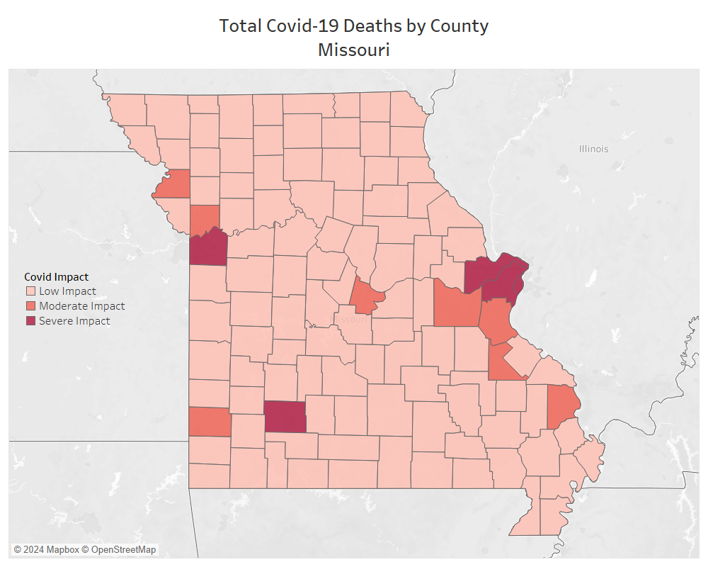
Impact on Missouri
Notes:
Next, I decided to focus on Missouri because it’s the state I live in, and I wanted to understand how severe the situation was locally. To visualize the impact across different areas, I categorized the total COVID-19 deaths into three levels:
- Severe impact: more than 300 deaths,
- Moderate impact: between 100 and 300 deaths,
- Low impact: less than 100 deaths.
At a more detailed level, the data supports our earlier observation that densely populated areas experienced the most significant impacts. Kansas City and St. Louis stand out as the hardest-hit regions, followed by Jefferson City and Columbia. This pattern highlights how urban areas, with higher population density, were particularly vulnerable to the spread of the virus. This also follows the trend that we saw towards the beginning where the states that have bigger cities and denser populations, have a higher risk.

Slide 9
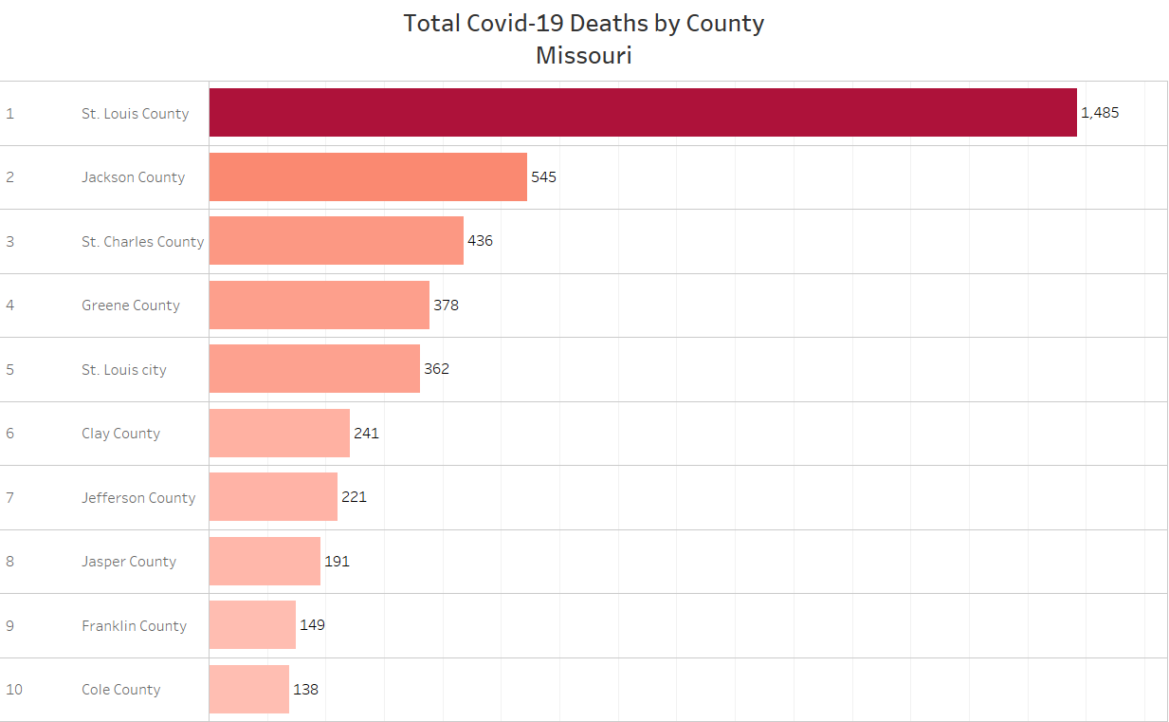
IMPACT ON Missouri: Most affected Counties
Notes:
Taking a closer look at the specific counties impacted, we can see that three of the top five counties belong to the St. Louis area, while one is in the Kansas City area. Interestingly, Greene County ranks fourth on the list. Located in Springfield, a well-known college town and home to Missouri State University, Greene County's high ranking may reflect the unique challenges faced by areas with large student populations. This data suggests that densely populated cities and college towns were particularly vulnerable to the spread of COVID-19, likely due to higher population density, frequent social interactions, and the nature of student populations. These insights emphasize the importance of targeted public health interventions in such areas during pandemics.

Slide 10
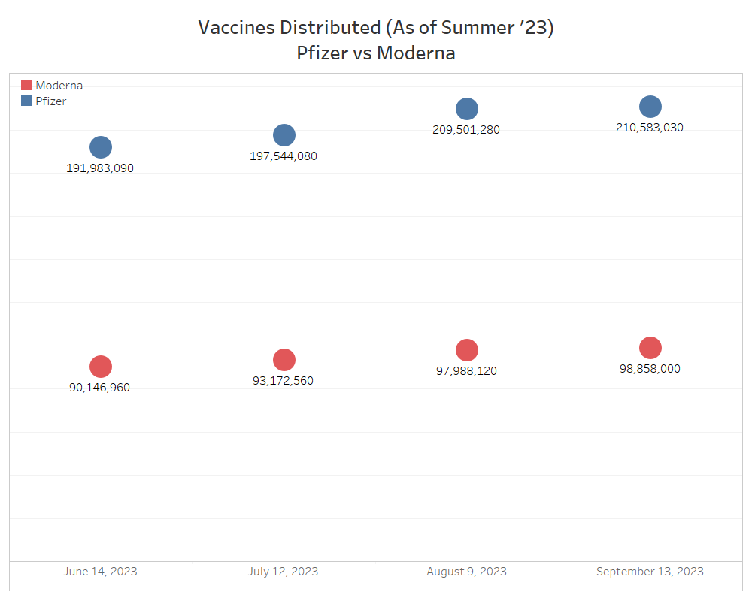
Dealing with the problem: Vaccines
Notes:
Now we move to the next section of the presentation, looking at how society responded to the challenges posed by the COVID-19 pandemic. One of the most immediate and critical reactions was the race to develop vaccines that could limit the spread of the virus and reduce its severity. Among the companies at the forefront, Pfizer and Moderna emerged as global leaders in the vaccine market. This chart highlights the distribution numbers for both companies as of September 2023. Pfizer took the lead, distributing over 200 million doses, more than double the amount distributed by Moderna. This dominance reflects Pfizer’s broader reach and perhaps stronger supply chain capabilities. Moderna, while trailing behind, still played a vital role in addressing the pandemic. These figures highlights the scale of global efforts to combat COVID-19 through vaccination.

Slide 11
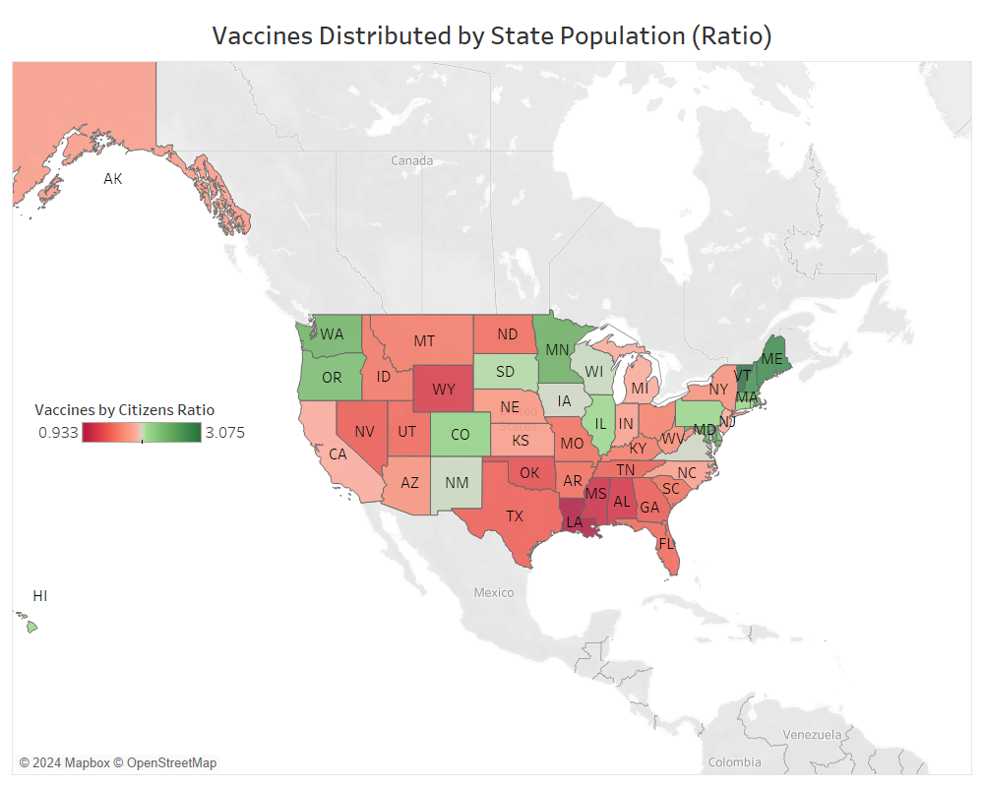
Americans’ Response to Vaccines
Notes:
But how did American citizens respond to the introduction of vaccines? I tried to answer this question by looking at the distribution of vaccines by each states’ population. Vaccination remains a highly controversial topic, as many people questioned the safety and effectiveness of a vaccine developed in such a short time with limited testing on humans. This skepticism led to the rise of anti-vaccine movements, with some citizens refusing to get vaccinated altogether. This map reflects these attitudes, showing significant differences in the ratio of vaccines distributed to the population across states. In some states, the ratio is less than one dose per person, while in others, it exceeds three doses per person. One notable trend is the resistance in southern states, where Louisiana, Mississippi, and Alabama show some of the lowest ratios. This pattern highlights regional disparities in vaccine acceptance and distribution, influenced by factors such as cultural attitudes, political leanings, and public health campaigns.

Slide 12
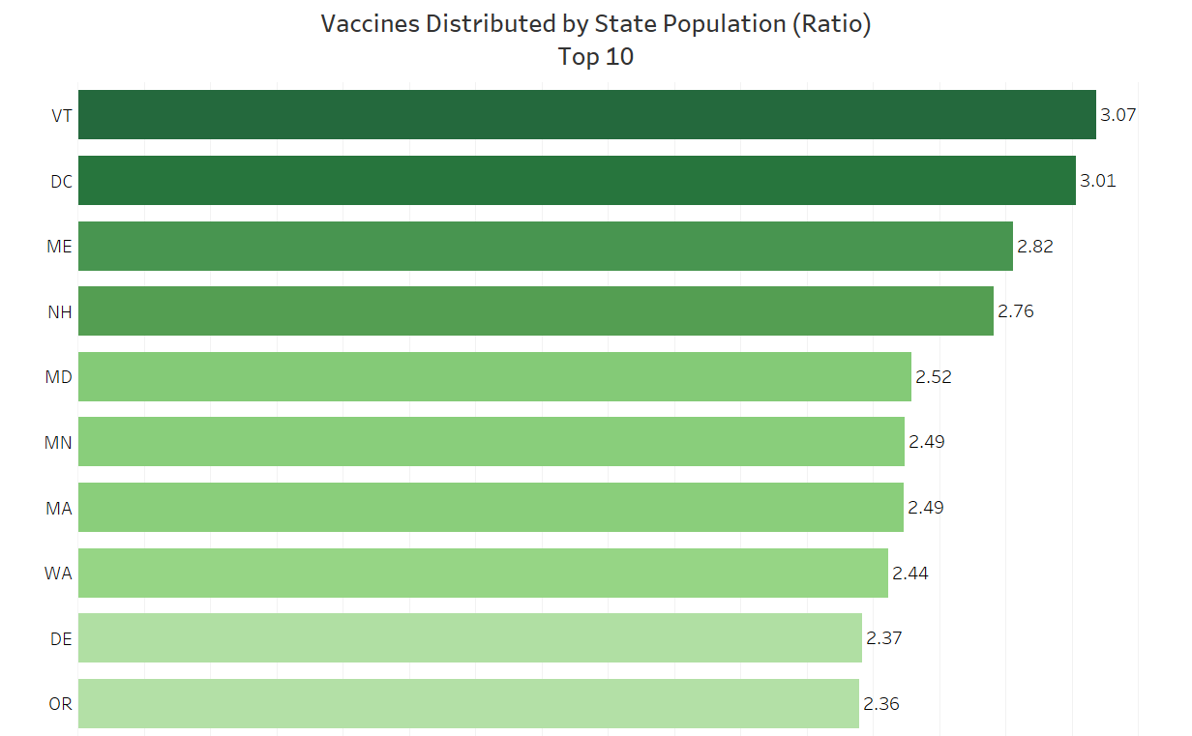
Most pro-vaccine States
Notes:
Focusing on the states that were most accepting of vaccines, Vermont, Washington D.C., Maine, New Hampshire, and Maryland lead the way, each with a ratio of around three doses per person. This highlights the Northeast as the most responsive/accepting region to vaccine distribution. Interestingly, the Northwest also showed strong openness to vaccination, with Washington and Oregon both making it into the top 10. These findings seem to confirm our previous hypothesis that regional attitudes, possibly influenced by public health initiatives, demographics, and political culture, played a significant role in vaccine acceptance and distribution.

Slide 13
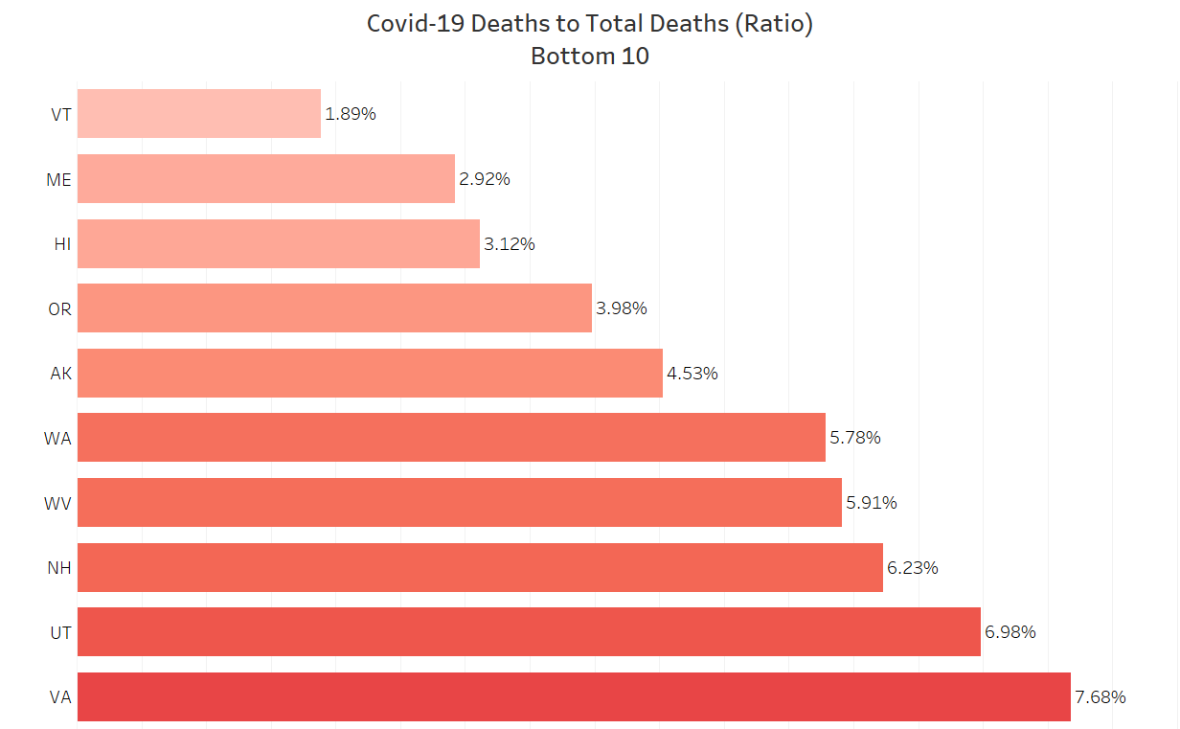





Expected consequences to vaccines distribution
Notes:
But the real question is: were these vaccines effective in tackling the COVID-19 crisis? Looking at this chart, we can assume that they definitely had a positive impact. Five of the 10 states with the lowest ratio of COVID-19 deaths to total deaths were also among the most vaccinated states in the previous slide. This strongly suggests that an effective vaccination system played a key role in reducing the proportion of deaths caused by COVID-19. While it’s important to acknowledge that other factors, such as healthcare infrastructure, public health policies, and demographic differences, also influence these outcomes, the consistent presence of these highly vaccinated states on this list is unlikely to be a coincidence. This further highlights the positive impact of widespread vaccination efforts in mitigating the effects of the pandemic.

Slide 14
Final Thoughts
Covid had a significant impact in the US
Vaccines proved to be an effective solution
Data analysis can uncover hidden patterns
Notes:
In conclusion, the data tells a clear and powerful story about the impact of COVID-19 and our collective response to it. First, the virus had a devastating effect, particularly on densely populated areas and vulnerable age groups, with older adults facing the highest risks for COVID-19 related deaths. However, on a deeper level, the ratio of COVID-19 deaths to Total Deaths shows that elders were not the only population affected. Second, vaccines played a critical role in reducing the severity of the pandemic, as shown by the correlation between high vaccination rates and lower ratios of COVID-19 deaths. While there were challenges like vaccine opposition and regional differences, this analysis shows how important data is for understanding the facts. Data helps us see the true impact of events and evaluate how well our responses work. By using data, we can make better decisions, fix gaps, and prepare for future challenges with clearer insights.

Slide 15
Thank you!

